Slide 1
Use of Force
for Today’s Police Officer

Slide 2
Use of Force Review
Goals for today Improve Knowledge & Confidence when using FORCE
Use of Force Continuum
Police Reform
Using of Force Today

Slide 4
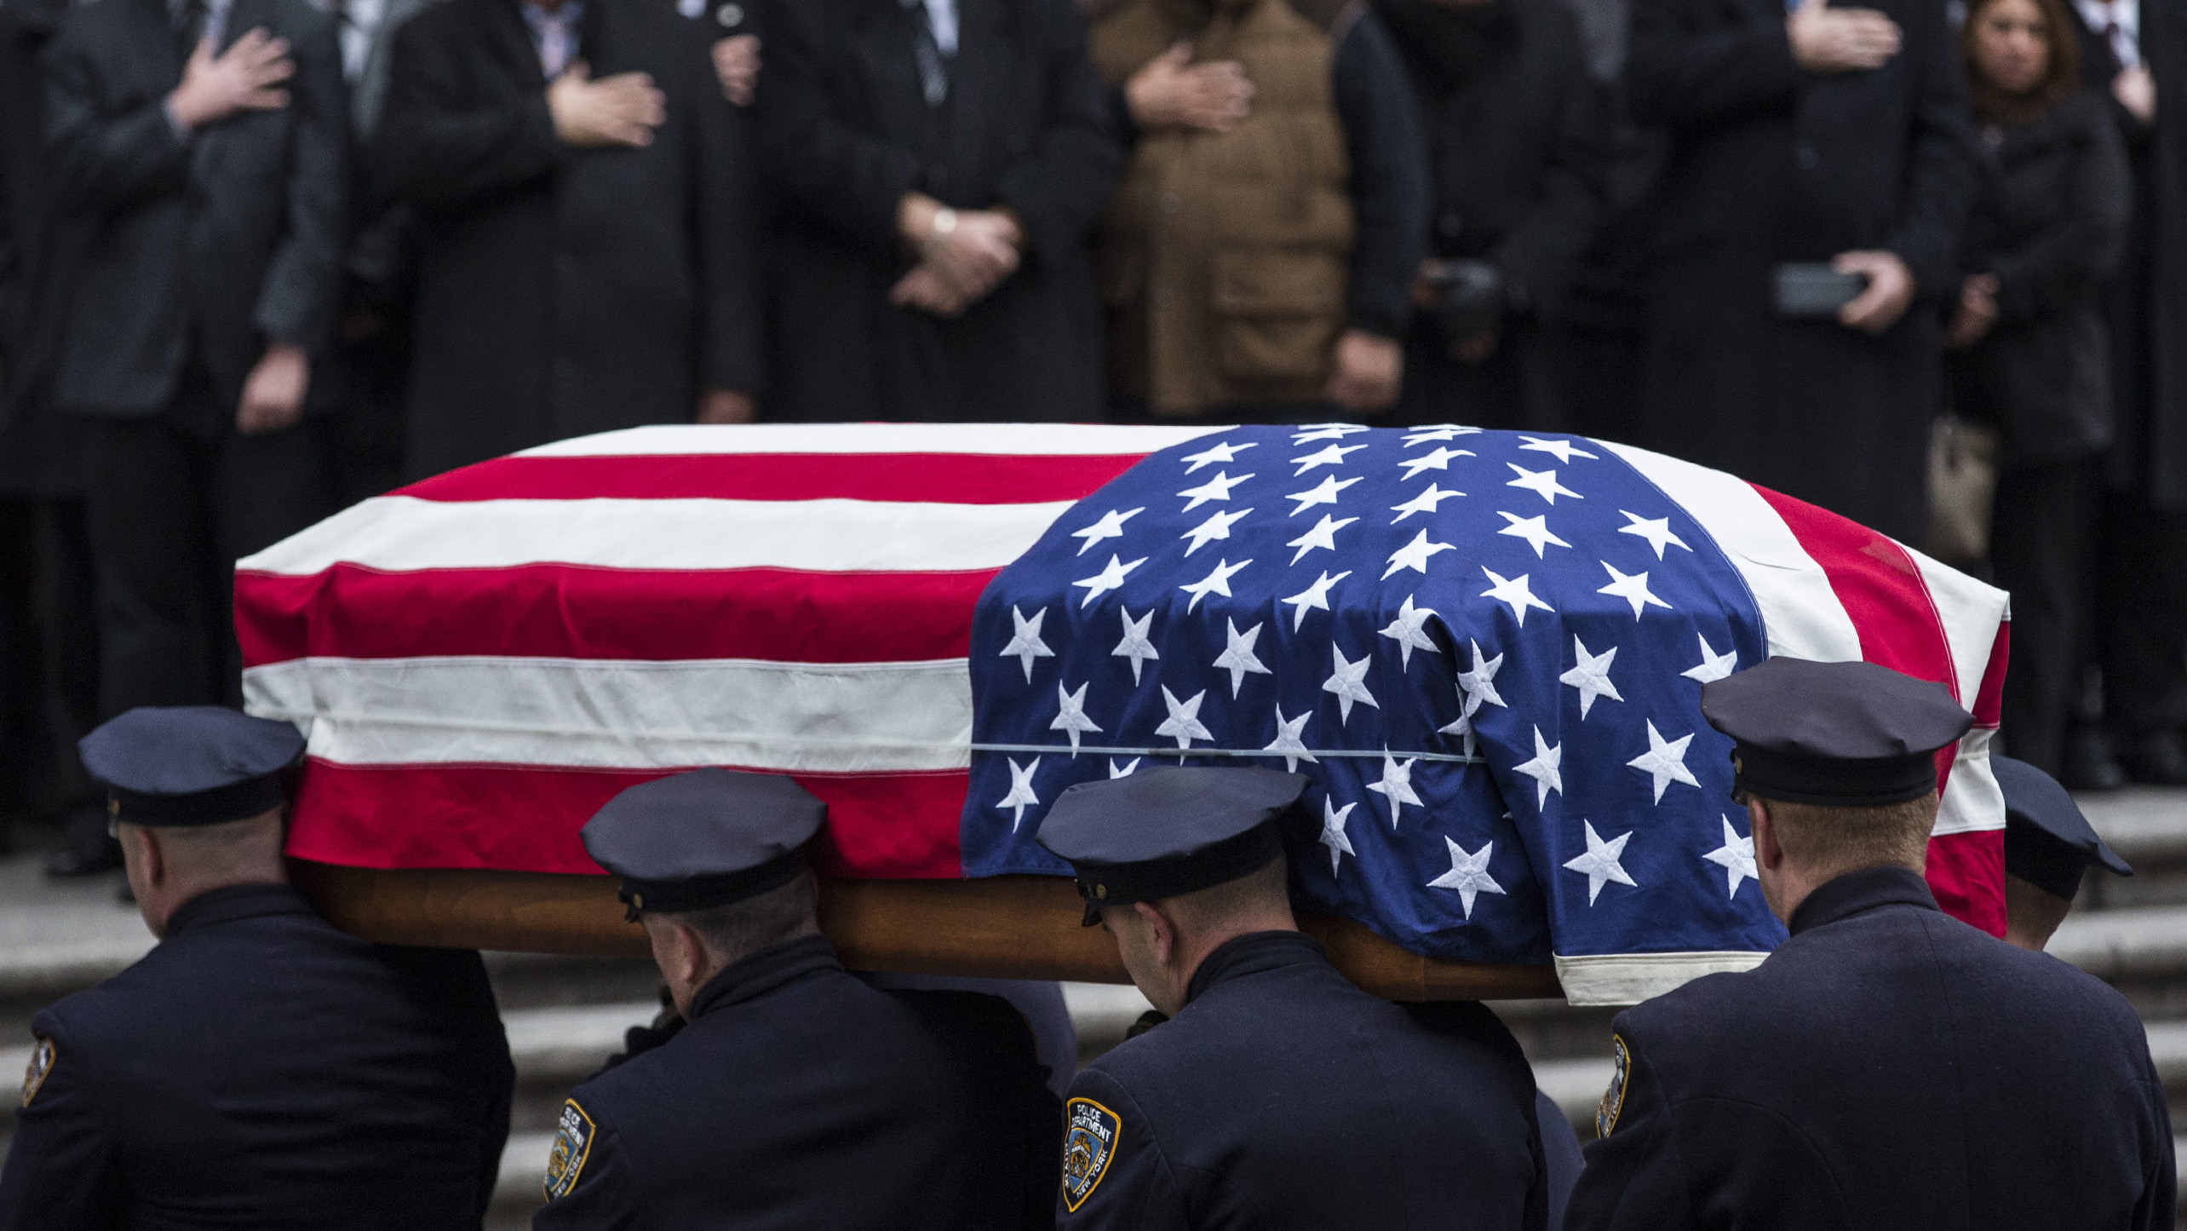
Underlying Circumstances
Police are more likely to be assaulted or killed during the following circumstances:
when making arrests
during motor vehicle stops
violent crimes in progress
domestic violence investigations
controlled substance investigations
suspects under the influence of drugs or alcohol
by persons who are suffering from mental health crisis

Slide 5
N.A.M.I. National Alliance on Mental Illness
Estimates show that people with serious mental illness are over ten times as likely to experience use of force in interactions with law enforcement than those without serious mental illness. This disproportionate impact is partially due to how officers interpret symptoms.

Slide 6
Protect & Serve
Dichotomy in Policing
I’m Here to HELP
He’s got a KNIFE!
Shots FIRED!
We’re not here to hurt you
Please don’t hurt him
Go home SAFE

Slide 7
Review relevant federal and state legal precedents that govern officer use of force.
Graham vs. Connor
Tenn. vs. Garner
550 CMR

Slide 8
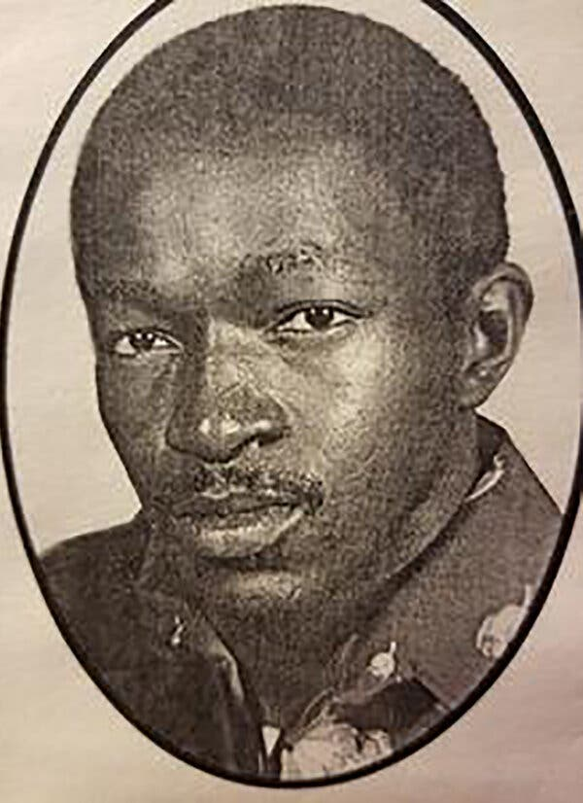
Graham v. Connor (1989)
Established that a use of force during an arrest or investigative stop is a seizure under the 4th Amendment.
The officer’s actions must be “objectively reasonable:”
in light of the facts and circumstances confronting them at the time
Dethorne Graham

Slide 9
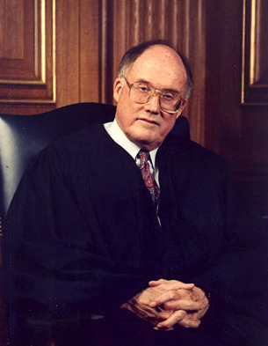
The Opinion of the Court –The Graham Factors
“The test of reasonableness under the 4th Amendment is not capable of a precise definition or mechanical application...Its proper application requires careful attention to the facts of each particular case, including:
the severity of the crime at issue,
whether the suspect poses an immediate threat to the officer or others and
whether or not he is actively resisting arrest or attempting to evade arrest by flight...”
Chief Justice William Rehnquist delivered the unanimous decision of the Court.

Slide 10
The Opinion of the Court, cont’d
“The ‘reasonableness’ of a particular use of force must be judged from the perspective of a reasonable officer on the scene, rather than with the 20/20 vision of hindsight...The calculus of reasonableness must embody allowance for the fact that police officers are often forced to make split-second judgments - in circumstances that are tense, uncertain and rapidly evolving…
Chief Justice William Rehnquist delivered the unanimous decision of the Court.

Slide 11
Consider the Totality of the Circumstances
Many factors compose the totality of the circumstances:
Description of environment Number of officers vs. the number of subjects Any de-escalation tactics employed Officer’s size, age, and conditions vs. those of subject History of violence known at the time of the incident History in general Any psychiatric history known at the time of the incident Any evidence of drug or alcohol use Presence of bystanders and the possible threat to them Specific actions of the subject throughout the incident Subject's reactions to commands or force used

Slide 12
Consider the Totality of the Circumstances
Many factors compose the totality of the circumstances:
Duration of action – how long did it last? How you used time to your advantage (what you did relative to command, control, planning, and de-escalation attempts). Injuries to the officers or others, including medical aid provided Level of exhaustion or fatigue of the officer ** Level of resistance while being restrained The availability of weapons – obvious weapons or weapons of opportunity Whether force applied injured/affected (or not) the suspect Whether medical aid was requested by or offered to the subject
** Force Science Study 100% to 30% in?

Slide 13
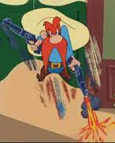
Tennessee v. Garner (1985)
Police may use deadly force to stop a fleeing suspect from escaping IF:
the suspect threatens the officer with a weapon; OR there is probable cause to believe the suspect has committed a crime involving the infliction or threatened infliction of serious physical harm; AND
deadly force is necessary to prevent escape; AND
where feasible, some warning was given.

Slide 14
Tennessee v. Garner (1985)
October 1974 @ 10:45 pm
Memphis police respond to a B&E in progress
Officers observe 1 suspect fleeing towards a fence
Nothing in hand / believed to be 17/18 yoa
Tenn statute & Memphis P&P allowed “All necessary means” to stop a felony.
Garner was shot as he tried to climb the fence
He was found to have $10 and a stolen purse

Slide 15
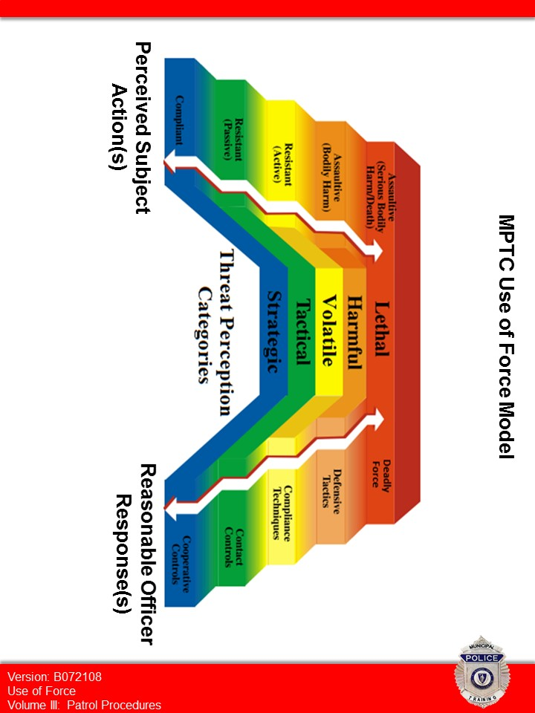
Suspect Actions vs. Officer Response
Excessive force can occur if the officer’s response is HIGHER than reasonable.
It can be unsafe if the officer’s response is LOWER than reasonable.

Slide 16
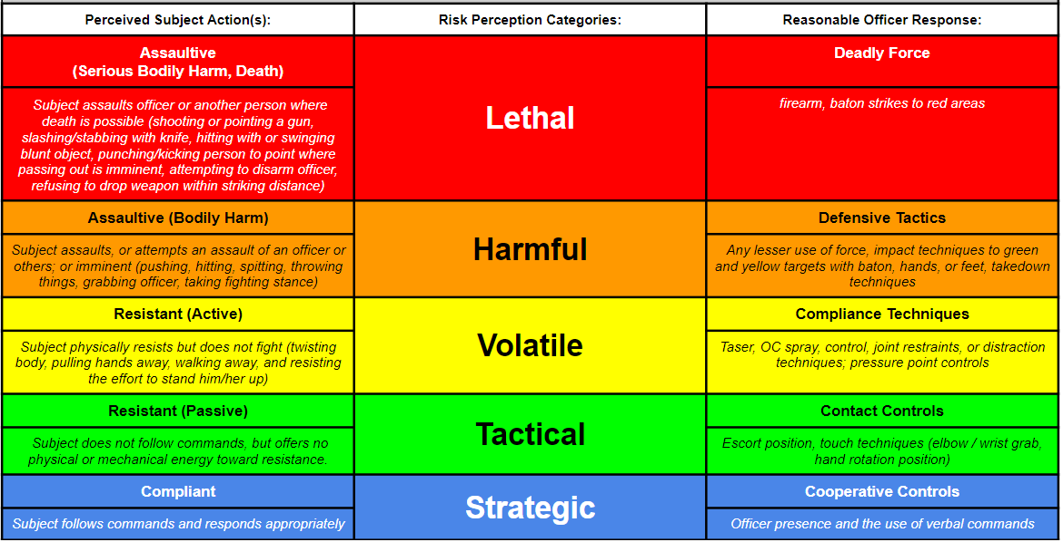

Slide 17
The Totality Triangle
Perceived
Circumstances
Perceived Subject
Action(s)
Reasonable
Officer Response(s)

Slide 18
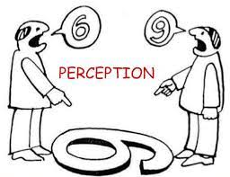
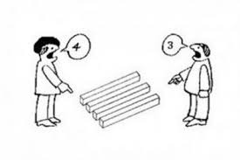
Perception
What is it and how does it impact policing?
Years on the job. Does this job change your perception?
Training and Experience
Lived Experiences – where you were raised and who raised you
Values, Norms & Morals
Friends, Family, & Co-Workers
Etc.

Slide 19
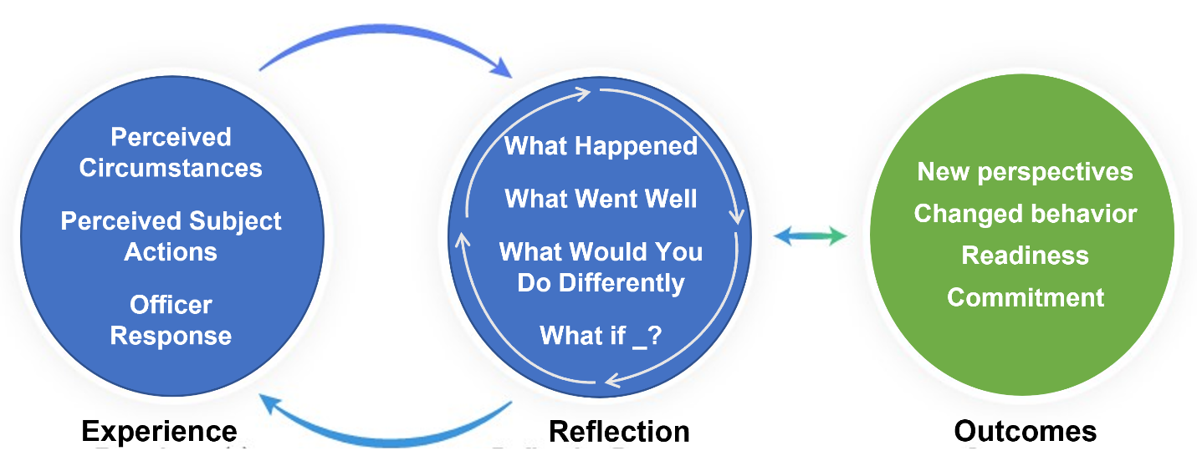

Slide 20
The Totality of the Circumstances
Courts consider the “totality” from the perspective of the “reasonable” officer on scene, including:
What was the type and severity of crime involved in the stop or arrest?
Did the suspect pose an immediate threat to officers or others?
Was the suspect actively resisting arrest or attempting to escape custody by flight?

Slide 21
Officer created jeopardy?

Slide 22
What is officer created jeopardy?
Governmental interest
Officer standing in front of a car that was involved in possession of a stolen car
Suicidal subject who is barricaded vs. hostage situation
How are they different?
How does our response change?

Slide 23
Officer created jeopardy?

Slide 24
Police in the Media
Video shows mentally ill man shot by police
'You just Tased an autistic kid, bro!'
Bodycam Captures Police Tase A 20-Year-Old With Severe Autism
Cop shoots, kills mentally ill teen
Officers charged in Louisiana shooting death of autistic boy
Illinois officer uses Taser on teen with autism in case of mistaken identity
Cop Shoots 13-Year-Old Autistic Boy After Mom Called 911
Community upset over fatal police shooting of mentally ill man

Slide 25
CASE DISCUSSION Armstrong vs. Pinehurt, NC
Review of the facts:
Armstrong was diagnosed with paranoid schizophrenia & bipolar
His sister persuaded him to self admit to the hospital after stopping meds & poking holes in his skin to “let the air out”.
Armstrong leaves prior to admission & police are call by hospital security
Police locate Armstrong in the road, but talk him to the side of the road
He is 5’11” & 265 lbs
Armstrong begins eating grass, dandelions & a gauze material
Police learn the “Section 12” has been sign & tell Armstrong he must return to the ER

Slide 26
CASE DISCUSSION Armstrong vs. Pinehurt, NC
Review of the facts:
Armstrong grabs a hold of a sign pole & refuses to let go
3 officers struggle to pull him from the sign w/ NO luck
2 hospital security guards attempt to help
Taser dry stun x 5 (in 2 min)
He is pried from the pole, then handcuffed & legs shackled
Armstrong is left face down on the ground

Slide 27
CASE DISCUSSION Meyers vs. Baltimore County, MD
Review of the facts:
Police receive calls from a mother about their 40yo bi-polar being involved in a physical altercation with her other son.
There was multiple previous calls (5x) to this residence & (3) resulted in transport of the hospital w/in 10 years
1st Officer arrived (father & injured brother are outside) - Meyers was inside & could be seen holding a BB bat.
Meyers is 6’ & 260 lbs
Negotiations are attempted but fail
Officers make entry

Slide 28
CASE DISCUSSION Meyers vs. Baltimore County, MD
4 Officers enter the home:
Police discharge taser in probe mode
#1 – has little effect
#2 – causes Meyers to drop the bat, but he is still standing
#3 – Meyers goes to the ground and officers move in pinning Meyers to the ground
Police struggle to control Meyers. One officer is seated on his back
#4 – A fourth taser deployment (re-energized)
Officer switched to Drive Stun mode and delivered 6 more Taser deployments
Drive stuns last between 2 – 4 seconds over the course of +1 minute

Slide 29
555 CMR 6.00 (POST): 550 CMR 6.00 (MPTC) USE OF FORCE BY LAW ENFORCEMENT OFFICERS
6.04: Use of Non-deadly Force
6.05: Use of Deadly Force
6.06: Duty to Intervene
6.07: Use of Force Reporting
6.08: Mass Demonstrations, Crowd Control, and Reporting
6.09: Investigation When Use of Force Results in a Death or Serious Bodily Injury
6.10: Use of Force Training

Slide 30
555 CMR 6.00 (POST) / 550 CMR 6.00 (MPTC)
6.04: Use of Non-deadly Force
(1) A law enforcement officer shall not use force upon another person, unless de-escalation tactics have been attempted and failed or are not feasible based on the totality of the circumstances and such force is necessary and proportionate to:
(2)A law enforcement officer shall use only the amount of force necessary against an individual who is engaged in passive resistance to effect the lawful arrest or detention of said individual and shall use de-escalation tactics where feasible, including issuing a summons instead of executing an arrest where feasible.

Slide 31
555 CMR 6.00 (POST) / 550 CMR 6.00 (MPTC)
6.05: Use of Deadly Force
(1) A law enforcement officer shall not use deadly force upon a person, unless de-escalation tactics have been attempted and failed or are not feasible based on the totality of the circumstances…
(1b) The officer attempts as many de-escalation tactics that are feasible under the circumstances, including utilizing barriers where feasible

Slide 32
Definition
CMR 6.03 defines force as:
“The amount of physical effort, however slight, required by police to compel compliance by an unwilling individual.”

Slide 33
S.I.R.F. Factors
When using force or when writing a use-of-force report, consider the following:
S – Severity of the crime (felony or misdemeanor)
I – Immediacy and severity of the threat
R – Resistance level
F – Flight risk

Slide 34
Verbal persuasion
Use force BEFORE attempting de-escalation (where/when feasible based on totality)
De-Escalation
Warnings
Proactive actions and approaches to stabilize a law enforcement situation.
More time, options, and resources to gain compliance.
Summons instead of arrest when feasible.
= Ofc. Don’ts
Slowing down the pace
Creating distance
= Definition
= Ofc. Dos
Reduce or eliminate the need for force
Requesting additional units

Slide 35
De-Escalation & Communication
Defined by MGL c 6E as:
Proactive actions and approaches used by an officer to stabilize a law enforcement situation so that more time, options, and resources are available to gain a person’s voluntary compliance and to reduce or eliminate the need to use force including, but not limited to verbal persuasion, warnings, slowing down the pace of an incident, waiting out a person, creating distance between the officer and a threat, requesting additional resources to resolve the incident including but not limited to calling in medical or licensed mental health professionals as defined in MGL c 111 sec 51 ½ (a) to address the potential medical or mental health crisis.

Slide 36
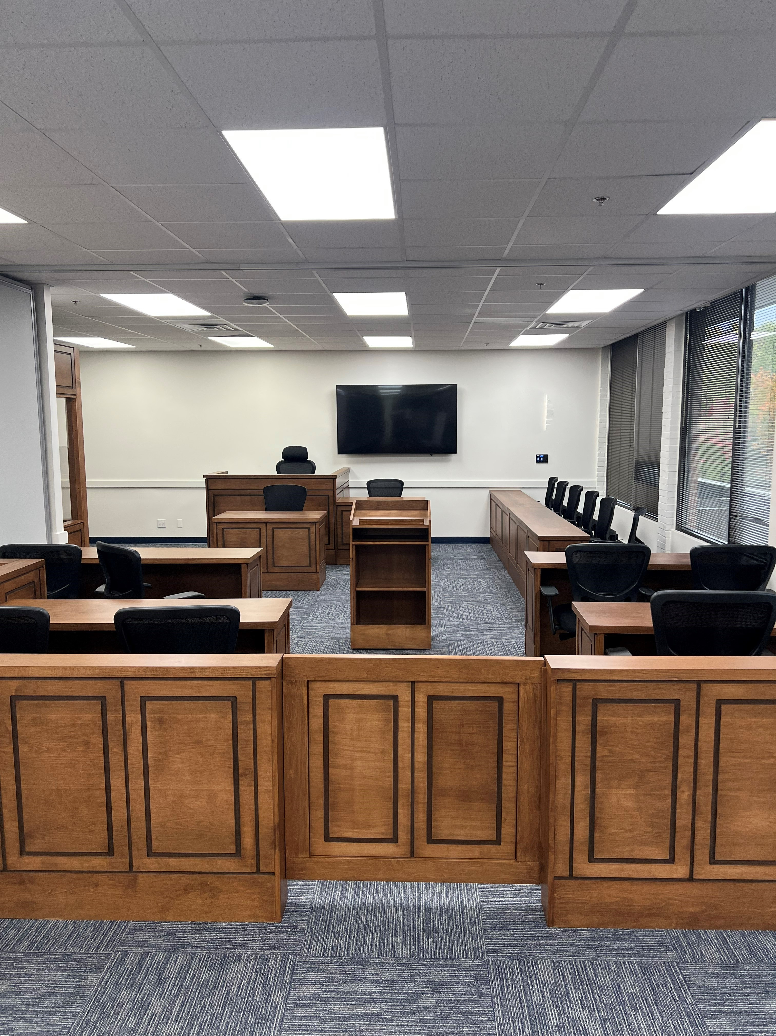
Legally justified, but was it avoidable
In Closing - What actions can you take to prevent becoming the next big story?

